Slide 1



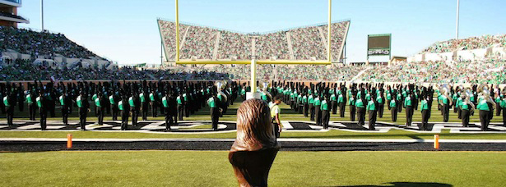
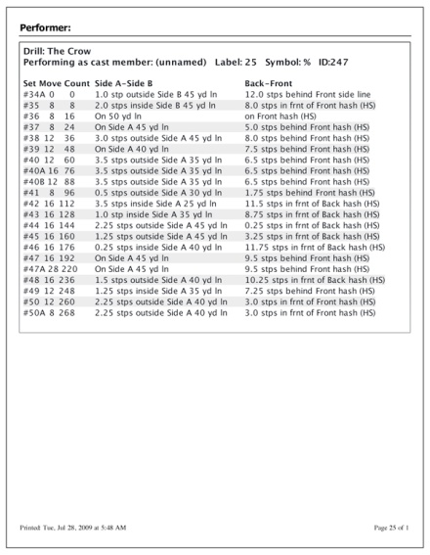
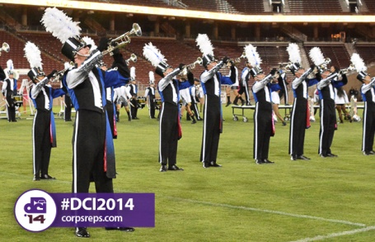
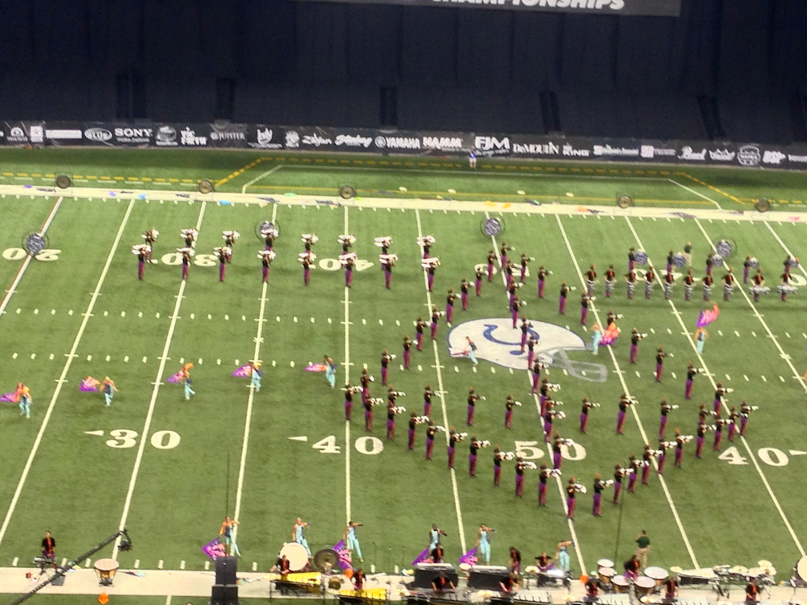
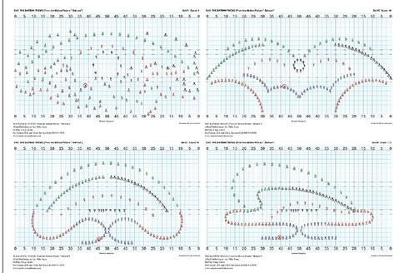

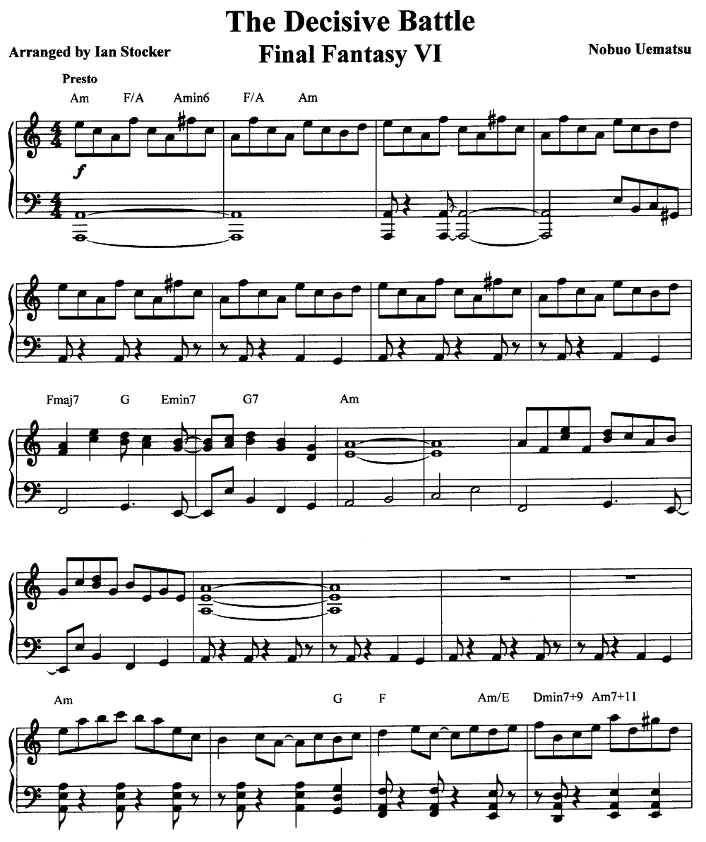

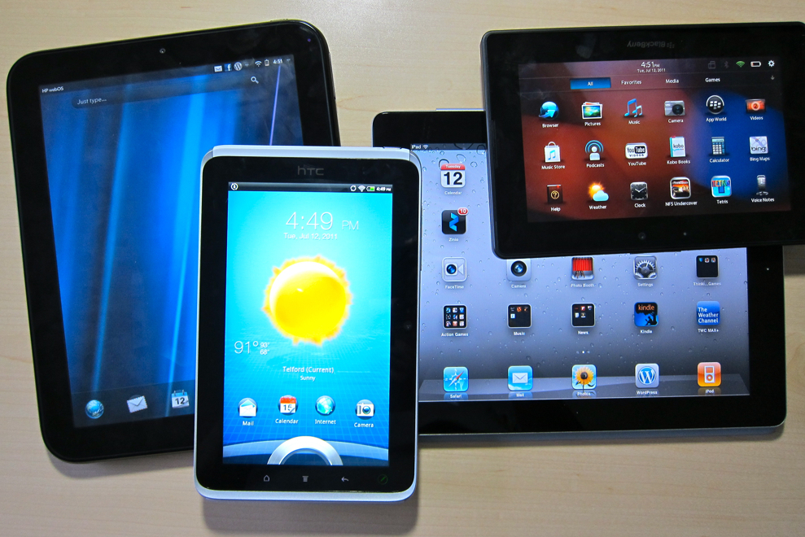
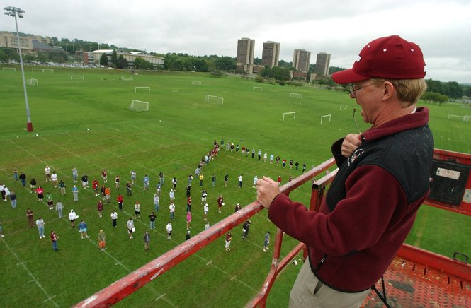


E-Marching
CSCE 4901: Software Development Capstone
Semester: Spring 2016
Instructor: David Keathly
Email: david.keathly@unt.edu
The Client:
Description of the Project:
This project consists of a teacher app and student apps that communicate directly with each other, giving the teacher the ability to guide the students who spread across the marching field/rehearsal room via a single device and allowing students to ask questions and take notes with ease. The program will focus on compiling all of the paperwork, sheet music, and coordinate sheets involved with students learning, rehearsing, and performing a marching band show onto their own personal devices and tablets. This will make the process of teaching easier and help the students stay organized with all of their papers. All apps will also have access to vital learning tools for a performing ensemble so that the students can practice with the app on their own. These apps will be designed for marching bands across the United States, but they can be adjusted to satisfy other indoor rehearsals for any type of ensemble.
Texas High School Band Director
Performed in 2 World Class Drum Corps - won the world championship with both groups
Participated on staff with multiple State Level high school marching bands
Graduate from the University of North Texas
Lessons Learned:
Planning ahead saves a ton of time and work down the road.
Clear and direct communication between team members keeps the project moving forward.
The internet is our best friend.
Problems Encountered/Resolved:
Android Studios was a new and unfamiliar coding environment for the team to work with and understand how to use.
Resolution: Utilized the internet to learn more about the IDE and look up tutorials that teach us how to both use and develop applications within Android Studios.
Most of the team members did not take the pre-requisite class(CSCE 4444) to this capstone class, causing the team to slow down with design and development because these students had to self teach themselves the design material.
Resolution: The team leader did most of the design work and documents since he was the only one to take the pre-requisite class.
Difficult trying to figure out how to use Android’s SQLite database to store and retrieve images onto and from the device or emulators.
Resolution: Resorted to storing the images on the online database and pulling them onto the device from there.
Work Remaining:
Mostly quality of life additions and adjustments such as:
Cleaner interface
Save activity instances when swapping between the music and coordinate pages, so that the user can return to their last active page of that type.
Adding a section to write notes for music pages and coordinate sets.
Future Expansions:
Music Educational Tools
Implementations of MusicXML and Pyware software
More direct communication features between the students and the teachers.
Team Nova Elite:
Team Leader -> Jason Hoang, Programmer -> Sabrin Thamed, Programmer -> KaiChuan Chan, Programmer -> Imran Ahktar

